Slide 1
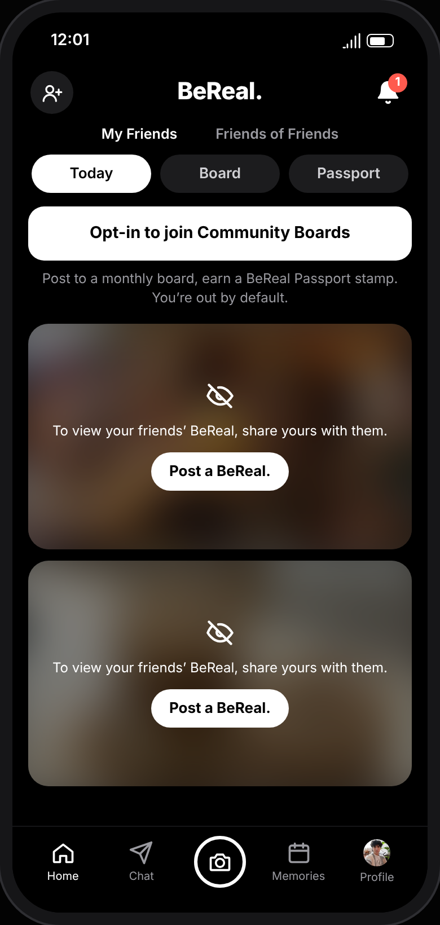
People love BeReal. Then they drift away.
THE PROBLEM
“I forget about it unless a friend mentions it.”
Occasional BeReal user, focus group
Daily users fell from about 15M to about 6M in 2022–23. One prompt a day; miss it, or the moment feels dull, and you skip.
BeReal Passport & Community Boards · Feature concept by Lashawn Fofung, MBA, CSM, CSPO
Notes:
Hi, I’m Lashawn, and today I want to show you how BeReal can win back the people who’ve quietly stopped posting.
People love BeReal’s realness, but most of them stop showing up. Daily users fell from about 15 million to about 6 million in a matter of months. [pause] When we asked why, one occasional user said: “I forget about it unless a friend mentions it.” [pause] BeReal gives you one prompt a day. Miss it, or the moment feels dull, and you skip. That’s our opportunity: give people a reason to come back, without adding pressure.

Slide 2
Three reasons people stop posting
WHAT WE LEARNED
1
2
3
Friends are the trigger
Ordinary moments feel not worth it
The novelty wears off
“It kind of got old after a while.”
“I forget about it unless a friend mentions it.”
“I skip posting if I’m just sitting at my desk doing nothing exciting.”
From a 5-person, 40-minute in-person focus group · October 2026
Notes:
So what’s behind the drift? We ran a 40-minute focus group with five people, from daily users to people who barely open the app. Three reasons kept coming up. Friends are the trigger. Ordinary moments don’t feel worth posting. And the novelty wears off: “It kind of got old after a while.” [pause] None of these is about wanting more pressure. People just need a reason to come back.

Slide 3
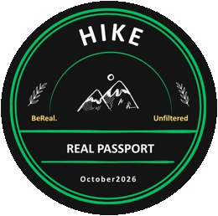
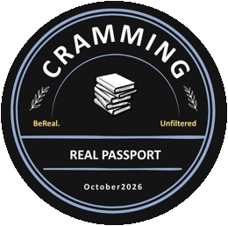
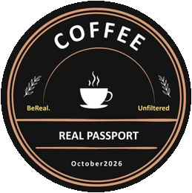
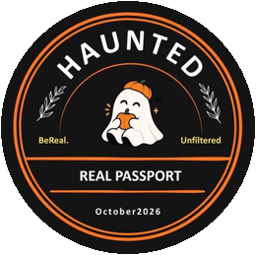
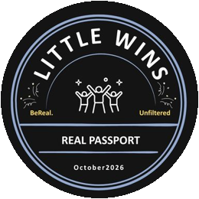
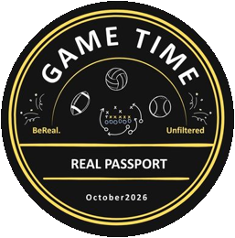
BeReal Passport & Community Boards
THE SOLUTION
Post your BeReal to a monthly board your squad shares, earn a collectible stamp, and save the month as a capsule. Opt-in, no filters, no public likes.
Friends are the trigger
Ordinary moments
The novelty wears off
→ boards you share with your squad
→ monthly themes make any moment fit
→ new stamp designs every month
Notes:
That’s why we designed BeReal Passport and Community Boards. Each month, your squad shares themed boards like Coffee, Hike or Cramming. Post your BeReal to one and you earn a collectible stamp; at the end of the month, the board becomes a capsule. Each piece answers what we heard: shared boards bring friends in, themes make any moment worth posting, and new stamps keep it fresh. And it stays BeReal: opt-in, the same real photo, no public likes.

Slide 4
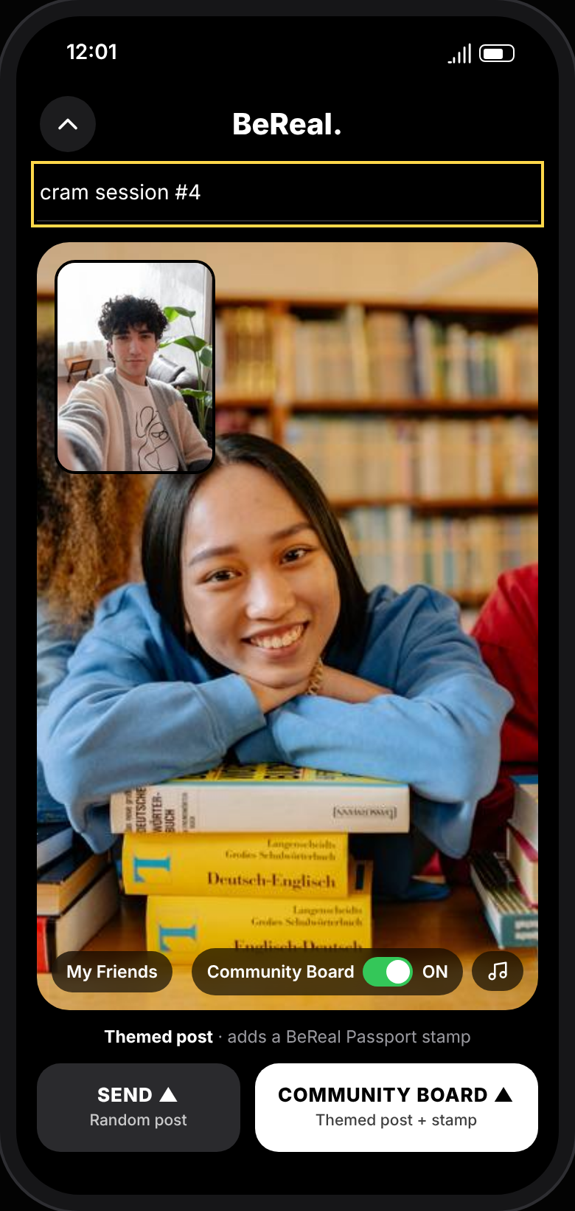
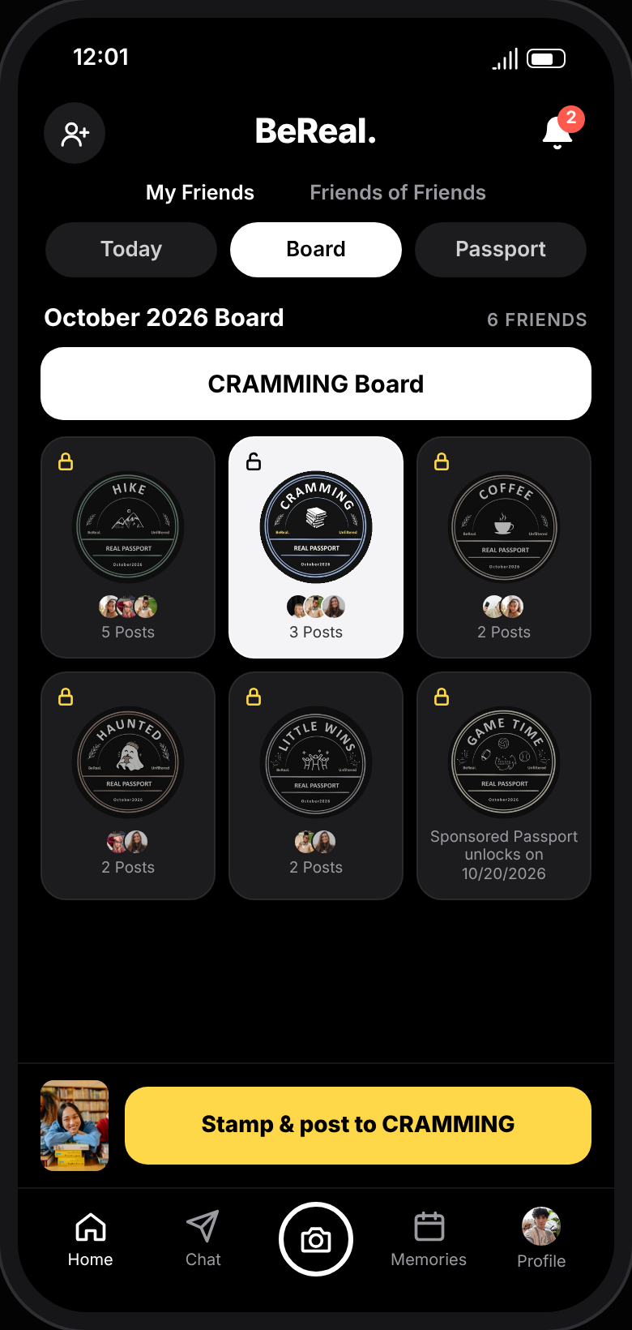
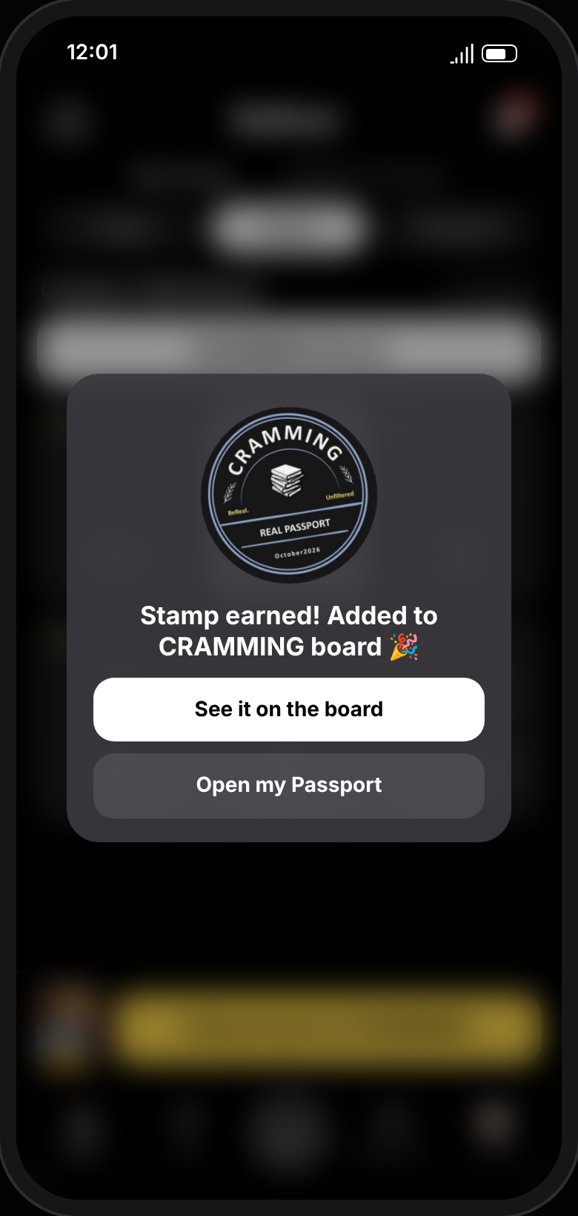
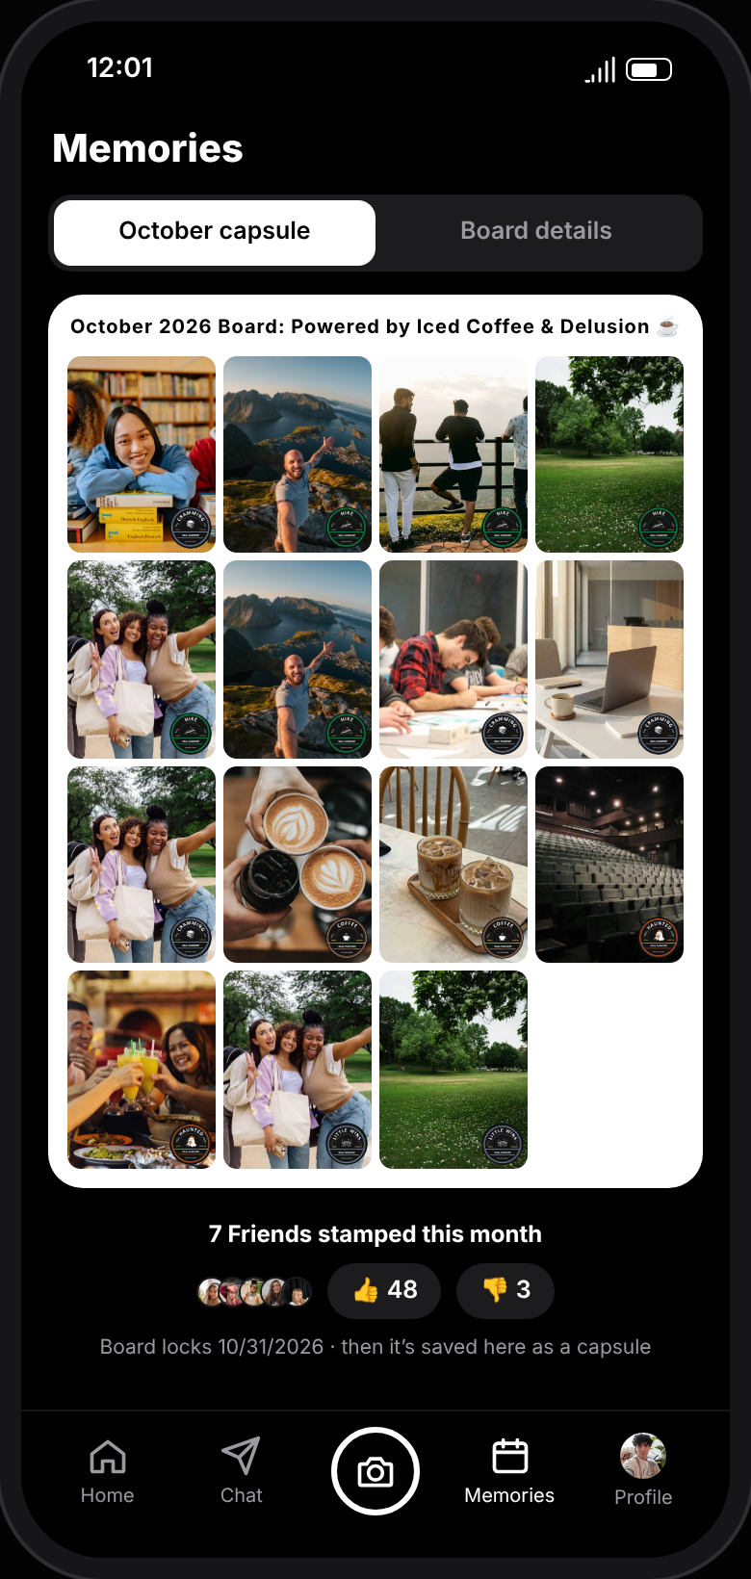
Four steps, one habit loop
HOW IT WORKS
1. Capture
2. Pick a board
3. Earn a stamp
4. Save the month
Take your BeReal like always and switch on Community Board.
Choose one of this month’s six shared boards.
Your post lands on the board with a Real Passport stamp.
Each board becomes a capsule in Memories.
Interactive Demo: https://lashawnfofung.github.io/BeReal-RealProcess/
Notes:
That’s why we designed BeReal Passport and Community Boards. Each month, your squad shares themed boards like Coffee, Hike or Cramming. Post your BeReal to one and you earn a collectible stamp; at the end of the month, the board becomes a capsule. Each piece answers what we heard: shared boards bring friends in, themes make any moment worth posting, and new stamps keep it fresh. And it stays BeReal: opt-in, the same real photo, no public likes.

Slide 5
4 of 5 would open BeReal more often
WHAT USERS SAID
“I’d definitely open the app more often because of this.”
Easy to understand
Occasional BeReal user
3.6
Feels authentic to BeReal
THE HONEST GAP
3.6
“There are a few too many button clicks in this flow.”
Would open BeReal more often
3.8
Reminders and streak felt low-pressure
4.2
Would you want BeReal to launch it?
Yes 3 · Maybe 1 · No 1
Average score out of 5 · 5 survey responses
Notes:
So, does it work? Four out of five testers said they’d open BeReal more often. [pause] One put it simply: “I’d definitely open the app more often because of this.” What surprised us most: the reminders and streak scored highest of anything for low pressure, 4.2 out of 5. [pause] We also heard a real gap: “a few too many button clicks.” That tells us what to fix, not whether to build it.

Slide 6
Bring back the users BeReal is losing
THE IMPACT
5/5
2.5×
4.2/5
Both occasional users rated “open BeReal more often” the top score
Target daily opens per user, to validate in the MVP
Low-pressure score: opt-in, time-boxed, no streak-loss guilt
We’ll measure
DAU / MAU
D7 and D30 retention
% of posts on boards
Taps from capture to post
Focus group of 5: these results show direction, not proof.
Notes:
Here’s why this matters for BeReal. Occasional users are the ones most likely to drift away, and both of them rated “open more often” 5 out of 5. [pause] Our target is 2.5 times more daily opens per user: a goal to prove in an MVP, not a result yet. With five testers, this shows direction, not proof. In the MVP, we’d track DAU over MAU, retention, and how many taps it takes to post.

Slide 7
Refine, then retest.
RECOMMENDATION
01
02
03
Cut taps from capture to stamp
Make SEND vs COMMUNITY BOARD clear
Add a first-use explainer
Next: retest with 7–10 people → MVP with one friend group and one board → full rollout
Thank you. Let’s keep BeReal real.
Lashawn Fofung, MBA, CSM, CSPO
Full Case Study: BeReal Case Study – Real Passport And Community Boards.pdf
Notes:
Here’s why this matters for BeReal. Occasional users are the ones most likely to drift away, and both of them rated “open more often” 5 out of 5. [pause] Our target is 2.5 times more daily opens per user: a goal to prove in an MVP, not a result yet. With five testers, this shows direction, not proof. In the MVP, we’d track DAU over MAU, retention, and how many taps it takes to post.

